Slide 1
Precept 6
Main topics:
Assignment 3: Passive Network Measurement
Due Friday, March 24th 11:59pm ET
Review / Deep Dive on BGP

Slide 2
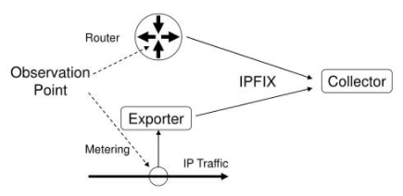
How was your assignment 3 data collected?
1) Traffic Measurement with IPFIX (IP Flow Information eXport) protocol
Goal: develop common IP traffic flow reporting protocol to be available on most routers
NetFlow - a proprietary form of IPFIX.
2) Interdomain Routing Measurement with BGP Routing Tables
To understand the state of Internet routing, many routers "dump" BGP routing tables periodically into a static file.
Contain information about each IP prefix, all BGP routes that the router learns for each prefix, and the "best" BGP route that the router selects.
Analyzing the BGP routing tables can provide information about where traffic to different IP prefixes is destined.
Notes:
you'll analyze a trace of NetFlow records captured from a router that connects the Princeton campus network to the Internet.
The assignment will ask you to perform similar kinds of analysis that a network operator would perform -- asking questions about the most popular endpoints for traffic on the Princeton campus, the most popular web applications, and so forth.

Slide 3
Network Flows
Packets or frames that have a common properties.
Examples: IP source/destination, Port source/destination, L4 protocol, VLANid
Creation and expiration policy
what conditions start and stop a flow.
Network Flows contain:
Counters – packets, bytes, time.
Routing information – AS, network mask, interfaces.
Peers – flow source and destination

Slide 4
Network Flows
Unidirectional or bidirectional flows
Bidirectional flows can contain other information such as round trip time, TCP behavior.
Application flows look past the headers to classify packets by their contents.
Aggregated flows – flows of flows.

Slide 5
Unidirectional Flow with Source/Destination IP Key
$ telnet 10.0.0.2
10.0.0.1
login:
10.0.0.2
Active Flows
Flow Source IP Destination IP
1 10.0.0.1 10.0.0.2
2 10.0.0.2 10.0.0.1
Slides from APRICOT 2008 Network Management

Slide 6
Unidirectional Flow with Source/Destination IP Key
$ telnet 10.0.0.2
$ ping 10.0.0.2
10.0.0.1
login:
10.0.0.2
ICMP echo reply
Active Flows
Flow Source IP Destination IP
1 10.0.0.1 10.0.0.2
2 10.0.0.2 10.0.0.1
Slides from APRICOT 2008 Network Management

Slide 7
Unidirectional Flow (IP, Port, Protocol Key)
$ telnet 10.0.0.2
$ ping 10.0.0.2
10.0.0.1
login:
10.0.0.2
ICMP echo reply
Active Flows
Flow Source IP Destination IP protocol srcPort dstPort
1 10.0.0.1 10.0.0.2 TCP 32000 23
2 10.0.0.2 10.0.0.1 TCP 23 32000
3 10.0.0.1 10.0.0.2 ICMP 0 0
4 10.0.0.2 10.0.0.1 ICMP 0 0
Slides from APRICOT 2008 Network Management

Slide 8
Aggregated Flow
Main Active flow table
Flow Source IP Destination IP protocol srcPort dstPort
1 10.0.0.1 10.0.0.2 TCP 32000 23
2 10.0.0.2 10.0.0.1 TCP 23 32000
3 10.0.0.1 10.0.0.2 ICMP 0 0
4 10.0.0.2 10.0.0.1 ICMP 0 0
Source/Destination IP Aggregate
Flow Source IP Destination IP
1 10.0.0.1 10.0.0.2
2 10.0.0.2 10.0.0.1
Slides from APRICOT 2008 Network Management

Slide 9
Bidirectional Flow (IP, Port, Protocol Key)
$ telnet 10.0.0.2
$ ping 10.0.0.2
10.0.0.1
login:
10.0.0.2
ICMP echo reply
Active Flows
Flow Source IP Destination IP protocol srcPort dstPort
1 10.0.0.1 10.0.0.2 TCP 32000 23
2 10.0.0.1 10.0.0.2 ICMP 0 0
Slides from APRICOT 2008 Network Management

Slide 10
Application Flow
Web server on
Port 9090
$ firefox http://10.0.0.2:9090
10.0.0.1
10.0.0.2
Content-type:
Active Flows
Flow Source IP Destination IP Application
1 10.0.0.1 10.0.0.2 HTTP
Slides from APRICOT 2008 Network Management

Slide 11
Analyze BGP Routing Tables
Which networks (i.e., autonomous systems) are responsible for sending or receiving traffic to the network.
Why do we need to know this?
The RouteViews project allows real-time information about the global routing system from the perspectives of several different ASs.
RouteViews servers act as software BGP routers, obtaining their BGP routing information via BGP sessions.
The main difference between the RouteViews servers and other BGP-speaking routers is that the RouteViews servers do not forward any real Internet traffic.
Notes:
IPFIX - top traffic flows at the level of IP addresses and ports
From our previous lectures on peering and Internet business relationships, it should be clear why an operator might care about knowing which ASes are sending traffic its way!
This information may also be useful for exploring various kinds of network attacks (e.g., sources of denial of service attacks)

Slide 12
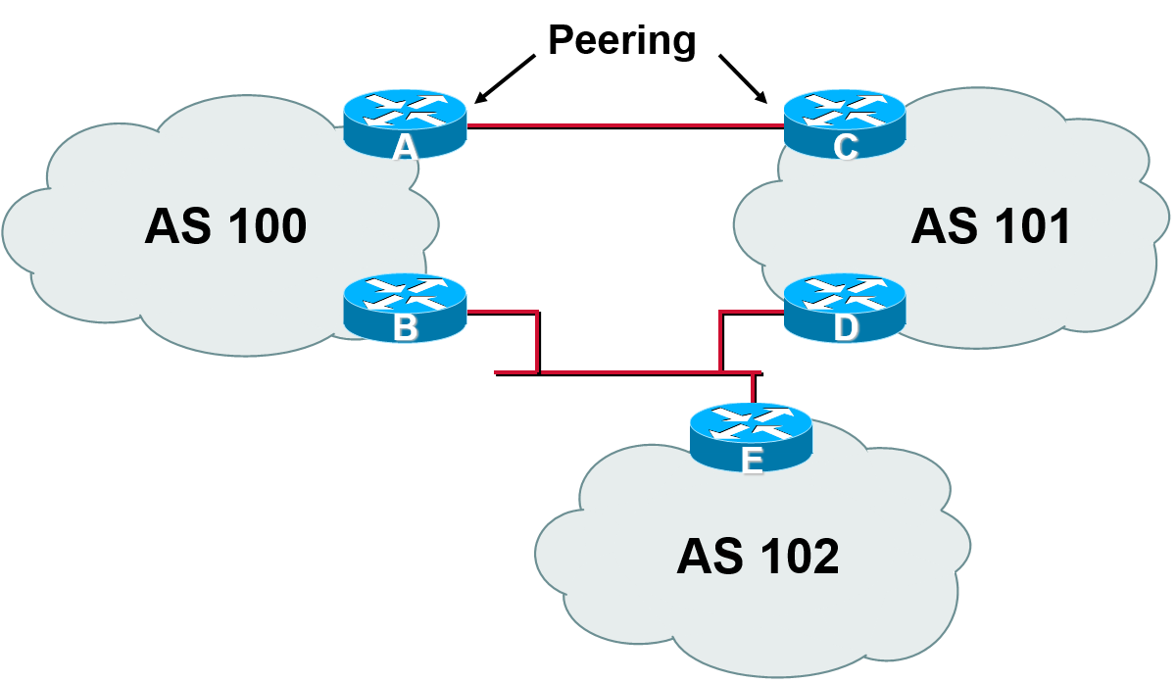
BGP Basics
BGP - internet exterior gateway protocol used between ISPs.
The characteristics:
Run over TCP
Path vector protocol
Incremental updates
BGP speaker - A router that advertises BGP messages and establishes peer relationships with other BGP speakers to exchange routing information.
BGP can be configured to run on a router in the following two modes:
iBGP (internal BGP) - When a BGP speaker peers with another BGP speaker that resides in the same AS
eBGP (external BGP) - When a BGP speaker peers with a BGP speaker that resides in a different AS
Peers (neighbors) - Any two routers that have formed a TCP connection in order to exchange BGP routing information
Notes:
When a BGP speaker receives a new route from another AS, it advertises the route to all the other BGP peers in the local AS.
Incremental update- allows advertising large amounts of routing information on the Internet.
Eliminates routing loops by adding AS path information to BGP routes.

Slide 13
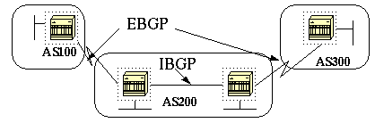
EBGP and IBGP
If an AS has multiple BGP speakers, it could be used as a transit service for other ASs.
It is necessary to ensure reachability for networks within an AS before sending the information to other external ASs.
Internal BGP peering between routers inside an AS
Redistributing BGP information to Internal Gateway Protocols running in the AS.
EBGP (Exterior BGP)
When BGP is running between routers belonging to two different ASs
Should be directly connected
IBGP (Interior BGP)
BGP running between routers in the same AS.
Not required to be directly connected
IBGP neighbors should be fully meshed
AS200 is a transit autonomous system for AS100 and AS300
Notes:
https://techhub.hpe.com/eginfolib/networking/docs/switches/K-KA-KB/15-18/5998-8164_mrg/content/ch15s15.html

Slide 14
General Operation
Learns multiple paths via internal and external BGP speakers
Picks the best path and installs in the IP forwarding table
Policies applied by influencing the best path selection
Notes:
13

Slide 15
General Operation
Information exchange between peers
BGP peers will initially exchange their full BGP routing tables.
From then on incremental updates are sent as the routing table changes.
Update message – path attribute information
BGP keeps a version number of the BGP table and it should be the same for all of its BGP peers.
The version number will change whenever BGP updates the table due to some routing information changes.
Keepalive packets ensure that the connection is alive between the BGP peers

Slide 16
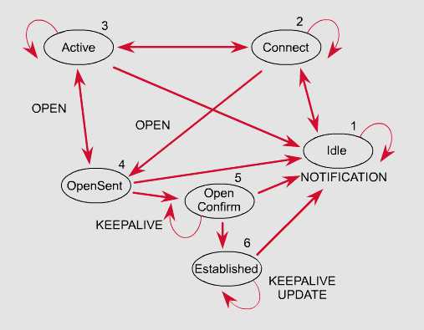
BGP FSM
The BGP neighbor negotiation process proceeds through various states, or stages, which can be described in terms of a finite-state machine (FSM).

Slide 17
BGP FSM
BGP FSM includes six states:
Idle
Connect
Active
OpenSent
Open Confirm
Established

Slide 18
BGP FSM
Idle State
BGP always begins in the Idle state, in which it refuses all incoming connections.
When Start event occurs, the BGP process:
Initializes all BGP resources
Starts the ConnectRetry timer
Initializes a TCP connection to the neighbor
Listens for a TCP initialization from the neighbor
Changes its state to Connect

Slide 19
BGP FSM
Connect State
In this state, the BGP process is waiting for the TCP connection to be completed.
If the connection is successful, the BGP process:
Clears the ConnectRetry timer
Completes initialization
Sends an Open message to the neighbor to identify itself and to specify its BGP operational parameters
Transitions to the OpenSent state
If the connection is unsuccessful, the BGP process:
Continues to listen for a connection to be initiated by the neighbor
Resets the ConnectRetry timer
Transitions to the Active state

Slide 20
BGP FSM
Active State
In this state, the BGP process is trying to initiate a TCP connection with the neighbor.
If the TCP connection is successful:
Clears the ConnectRetry timer
Completes initialization
Sends an Open message to the neighbor
Transitions to the OpenSent state
If the ConnectRetry timer expires while BGP is in the Active State, the BGP process:
Transitions back to the Connect state
Resets the ConnectRetry timer

Slide 21
BGP FSM
OpenSent State
In this state an Open message has been sent and BGP is waiting to hear an Open message from its neighbor.
When an Open message is received, all its fields are checked.
If errors exist, a Notification message is sent and the state transitions to Idle.
If no errors exist, a Keepalive message is sent and the Keepalive timer is set, the peer is determined to be internal or external, and state is changed to OpenConfirm.

Slide 22
BGP FSM
OpenConfirm State
In this state, the BGP process waits for a Keepalive or Notification message.
If a Keepalive message is received, the state transitions to Established.
If a Notification message is received, or a TCP disconnect is received, the state transitions to Idle.

Slide 23
BGP FSM
Established State
In this state, the BGP connection is fully established and the peers can exchange Update, Keepalive and Notification messages.
If an Update or Keepalive message is received, the Hold timer is restarted.
If a Notification message is received, the state transitions to Idle.

Slide 24
BGP - Update messages
BGP path attributes
AS path
Next hop
Local preference
Multi-Exit Discriminator (MED)
BGP community
Notes:
7

Slide 25
AS-Path
Sequence of AS a route has traversed
Loop detection
Apply policy
AS 200
AS 100
170.10.0.0/16
180.10.0.0/16
180.10.0.0/16 300 200 100
170.10.0.0/16 300 200
AS 300
AS 400
150.10.0.0/16
AS 500
180.10.0.0/16 300 200 100
170.10.0.0/16 300 200
150.10.0.0/16 300 400
Cisco Systems
Notes:
19

Slide 26
Next Hop
150.10.1.1
150.10.1.2
AS 200
150.10.0.0/16
AS 300
A
B
150.10.0.0/16 150.10.1.1
160.10.0.0/16 150.10.1.1
AS 100
Next hop to reach a network
Usually a local network is the next hop in EBGP session
160.10.0.0/16
Cisco Systems
20
Notes:
20

Slide 27
IBGP Next Hop
150.10.1.1
150.10.1.2
C
AS 200
150.10.0.0/16
A
B
AS 300
150.10.0.0/16 150.10.1.1
160.10.0.0/16 150.10.1.1
AS 100
160.10.0.0/16
Next hop not changed
Cisco Systems
Notes:
22
IGP should carry route to next hops
Recursive route look-up
Unlinks BGP from actual physical topology
Allows IGP to make intelligent fowarding decision

Slide 28
Third Party Next Hop
AS 200
192.68.1.0/24 150.1.1.3
C
150.1.1.1
150.1.1.2
150.1.1.3
A
B
More efficient
192.68.1.0/24
AS 201
Cisco Systems
Notes:
21

Slide 29
Local Preference
AS 100
160.10.0.0/16
AS 200
AS 300
D
500
800
E
Local to an AS
Used to influence BGP path selection
Path with highest local preference wins
A
B
AS 400
160.10.0.0/16 500
> 160.10.0.0/16 800
C
Cisco Systems
Notes:
24

Slide 30
Multi-Exit Discriminator (MED)
AS 200
C
192.68.1.0/24 2000
192.68.1.0/24 1000
A
B
192.68.1.0/24
AS 201
Cisco Systems
Notes:
26

Slide 31
Multi-Exit Discriminator
Non-transitive
Used to convey the relative preference of entry points
Influences best path selection
Comparable if paths are from same AS
IGP metric can be conveyed as MED
Cisco Systems
Notes:
27

Slide 32
Communities
BGP attribute
Used to group destinations
Each destination could be member of multiple communities
Community attribute carried across ASs
Useful in applying policies
Cisco Systems
Notes:
30

Slide 33
Community
160.10.0.0/16 1000
190.10.0.0/16 1000
170.10.0.0/16 1001
180.10.0.0/16 2000
AS 400
H
AS 500
G
E
F
AS 300
170.10.0.0/16 1001
160.10.0.0/16 1000
C
D
180.10.0.0/16 2000
190.10.0.0/16 1000
A
B
AS 100
AS 200
Cisco Systems
Notes:
31

Slide 34
Applying Policy with BGP
Decision Process
Phase I - Calculating the degree of preference for each route based on the local preference attribute
Phase II - Choosing the best route with highest degree of preference
Phase III – dissemination to peers in neighboring ASs, route aggregation and information reduction
Policy-based on AS path, community or the prefix
Rejecting/accepting selected routes
Set attributes to influence path selection
Notes:
32

Slide 35
Overlapping Routes
BGP speaker may transmit routes with overlapping NLRI Information
Overlap occurs when a set of destinations are identified in non-matching routes
Destinations are always identified by IP prefixes
More specific prefix route gets precedence.

Slide 36
Breakout rooms
What would the uses for flow be?
Why measure BGP?
Why is end-to-end paths are significantly longer than necessary
Notes:
Identification/solving
Traffic classification
Flow-based detection
Dos traceback
Peering and Internet business relationships, it should be clear why an operator might care about knowing which Ases are sending traffic its way!
This information may also be useful for exploring various kinds of network attacks (e.g., sources of denial of service attacks)
Topology and routing policy choices within an ISP, between pairs of ISPs, and across the global Internet.
Peering policies and interdomain routing lead to significant inflation
Interdomain path inflation is due to lack of BGP policy to provide convenient engineering of paths across ISPs
Traffic Analysis
Inter-AS traffic analysis
Reporting on application proxies
Acounting
Cross verification from other sources
Can cross-check with SNMP data

